Slide 1
National
Campus Mental Health
Community of Practice
Webinar
December 3, 2015
Hosted by
Canadian Association of College and University Student Services
In collaboration with
Canadian Mental Health Association

Slide 2
Welcome and Introduction

Slide 3
Development of the National Guide took place between during 2010 – 2013
Su-Ting Teo (Ryerson University) and Cheryl Washburn (University of British Columbia) co-chaired the National Working Group and Steering Committee
300 representatives from over 70 post-secondary institutions across Canada participated
Was the beginning of a National Community of Practice (CoP)
For more details visit > https://healthycampuses.ca/project/post-secondary-student-mental-health-guide-to-a-systemic-approach/

Slide 4
Co-Chairs of the CoP

Slide 5
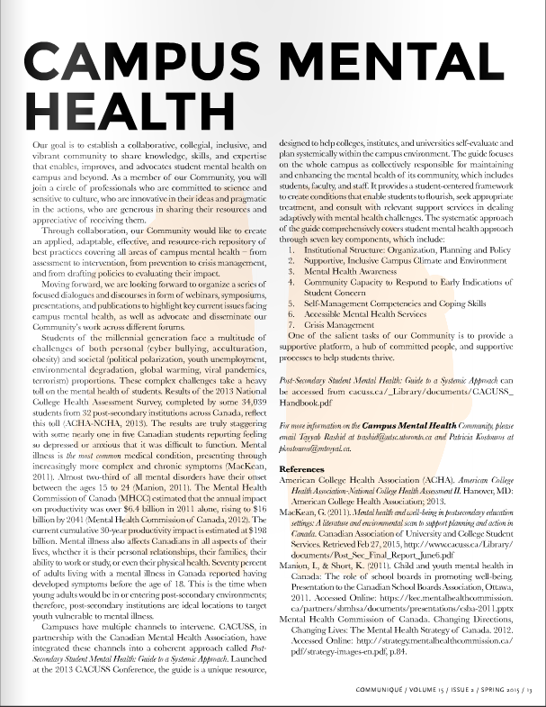
http://issuu.com/cacuss/docs/cacuss_q2_2015__1_

Slide 6
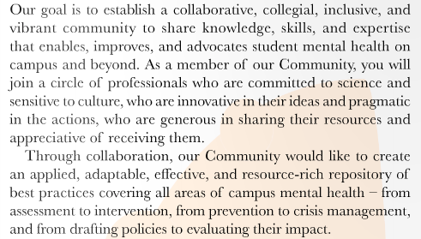

Slide 7
Agenda
1
Insights from the Survey about the Guide
2
Common Interests, Concerns and Hopes
3
Knowledge and Resources of Top Priority
4
CoP Methods for Sharing and Co-Creating
5
Final Thoughts and Next Steps

Slide 8
Insights from the Survey about the National Guide

Slide 9
How Canadian Campuses are using The guide to Systematically Approach Mental Health
Tayyab Rashid, University of Toronto Scarborough Patricia Kostouros, Mount Royal University Ashley Humeniuk, University of Calgary
December 3rd, 2015

Slide 10
Outline
Survey development
Preliminary survey results
Next steps and recommendations

Slide 11
Survey on use and knowledge of the Guide
Origin and goal of the survey
Survey development
Collaborative process
Emphasis on appropriate/effective language
Focused and succinct

Slide 12
demographics
Who participated in the survey

Slide 13
Survey Preliminary Results
Data Collection: Spring-Summer, 2015
87 Total respondents
61 complete; (70%) completion rate
Average time of completion was 3:19
Responses were received from 41 different Canadian colleges and universities.
Complete surveys were submitted by individuals from 35 unique institutions;
Incomplete surveys were submitted by individuals from another 6 unique institutions.

Slide 14
Participating Post-Secondary Institutions (n=34)
Atlantic 1.Memorial University, St John's, NL 2. St. Thomas University, Fredericton, NB 3. University of New Brunswick, Fredericton, NB 4. Universite´ Sainte-Anne, Nova Scotia 5. Nova Scotia College of Arts & Design (NSCAD), NS Quebec & Ottawa 1. Concordia University 2. McGill 3. Carleton University, Ottawa | Central (Prairies) 1. University of Manitoba 2. Alberta College of Art and Design 3. Keyano College, Fort McMurray, AB 4. MacEwan University, Edmonton, AB 5. Mount Royal University, Calgary 6. The Northern Alberta Institute of Technology in Edmonton, Alberta 7. University of Saskatchewan 8. University of Winnipeg
Ontario 1. Brescia University College, London 2. Centennial College, Toronto 3. Brescia University College, London 4. Georgia College, Barrie 5. Humber College, Toronto 6. McMaster University, Hamilton 7. Northern Ontario School of Medicine, Sudbury 8. Queen’s University, Kingston 9. Redeemer University College, Ancaster 10. Ryerson University, Toronto 11. University of Guelph, Guelph 12. University of Toronto Scarborough 13. Western University, London | West 1. British Columbia Institute of Technology (BICT) 2. Douglas College, B.C 3. Simon Fraser University (SFU) 4. University of British Columbia 5. Vancouver Island University

Slide 15
Primary Roles of Responders (n=84)

Slide 16
My institute has developed a systematic approach to Student Mental Health (n=83)

Slide 17
Awareness of the national guide

Slide 18
Prior to this survey, were you aware of the Guide? (n=84)

Slide 19
How were you made aware of the Guide? (n=39)

Slide 20
Interest in learning more about the Guide (n=36)

Slide 21
Feedback
Usefulness

Slide 22
Do you find the Guide useful? (n=39)

Slide 23
How useful is the Guide in the following areas?

Slide 24
Additional comments on the Guide's usefulness
“Helped to coordinate responses and thoughtful planning”
“The framework of the components has been the most useful”
“Helpful to have the summary of supporting research/references”
“It was the framework we used to drive our campus-wide consultation process and recommendations…”
“Loved the simple models like the funnel of students. The examples were superb and really helpful.”
“I think it is a useful high level framework to help spark campus specific actions”
“The guide does little to acknowledge and address the role of Accessibility/Disability Services in supporting mental health”

Slide 25
Specific barriers that limit the usefulness of the Guide
Fragmented systems
Does not address “meaning-making/faith formation
Limited examples provided
No way to assess seven areas of the Guide
No guidance on how to prioritize initiatives
General resource that does not include sufficient detail that is usually contained within a “guide”
Institutional commitment (staffing, time, funds, etc.)
Lack of understanding of issue by senior administration – more of a “sales pitch” would be helpful

Slide 26
Feedback
Impact

Slide 27
Some specific examples of how the Guide has been used
Assisted in clarifying roles, needs and directions.
Used as template for developing systematic response to mental health concerns of students.
Used to conduct an environmental scan/self-study
Referenced for funding and other resource(s) applications
Influenced creation of working groups and committees
Used to demonstrate to senior leadership and others the importance of mental health strategizing on campus
Helped to make a challenging task more manageable
Encouraged review of current policies to account for mental health needs.

Slide 28
Is the use of the Guide changing and/or having an impact on student mental health at your campus? (n=32)

Slide 29
What changes are evident due to your use of the Guide?
More guidance for referral and understanding of roles
“Stronger consistency in response” and greater awareness of the negative aspects of post-secondary “culture”
“We are much more cognizant of preventive programming…”
Greater acceptance and “buy-in” from senior leadership and stakeholders
“Heightened interest by staff and lowered stigma”
“…changes are happening within learning environments, policies and other areas”

Slide 30
Specific barriers to introducing the systematic approach detailed in the Guide

Slide 31
Feedback
Recommendations

Slide 32
Specific suggestions to improve the usefulness of the Guide
Development of a companion piece, accessible in Word, that could serve as a workbook (with the “hows”).
Provide additional examples to guide implementation including how other institutions have used it.
“Perhaps a follow-up document could be a series of case studies”
Develop on-line interactive sections
Strategy for prioritizing the recommendations of the guide.
Strategies for developing partnerships.
Additional templates that could be modified for planning, assessment, core messaging.

Slide 33
Becoming more familiar with the Guide

Slide 34
Additional comments, concerns, or ways to improve the knowledge and usage of the Guide
“I would love to see the Guide address the connection between meaning-making/faith formation and mental health.”
“We have dollars to send people to one event. It needs to include great sessions for administrators at the VP or Executive Director level. These are the change makers.”
“I look forward to having a more practical understanding of how to implement the Guide at our University using our existing resources.”
“I found the Guide to be a great resource in helping organize the multiple things that we should be attending to.”

Slide 35
Reflections

Slide 36
Group Dialogue

Slide 37
What common interests, concerns or hopes regarding Campus Mental Health bring us together as a community?

Slide 38
What knowledge and resources are top priority for us to share and develop together?

Slide 39
As an emerging National CoP how can we share promising practices and co-create new knowledge and resources that will benefit all?

Slide 40
Final Thoughts and Next Steps
: February 11, 2016 and April 7, 2016

Slide 41
Getting Involved
Alternatively:
You can email the Co-Chairs to request to be added to the mailing list
trashid@utsc.utoronto.ca
amhumeni@ucalgary.ca

Slide 42
Thank You

