Slide 2
Suicide and the Work Environment
By
Dr. Kathleen Stephany RN, PHD, CCC, Psychologist

Slide 3
Practical Information & Insights on How to Help Someone Who is Suicidal

Slide 4
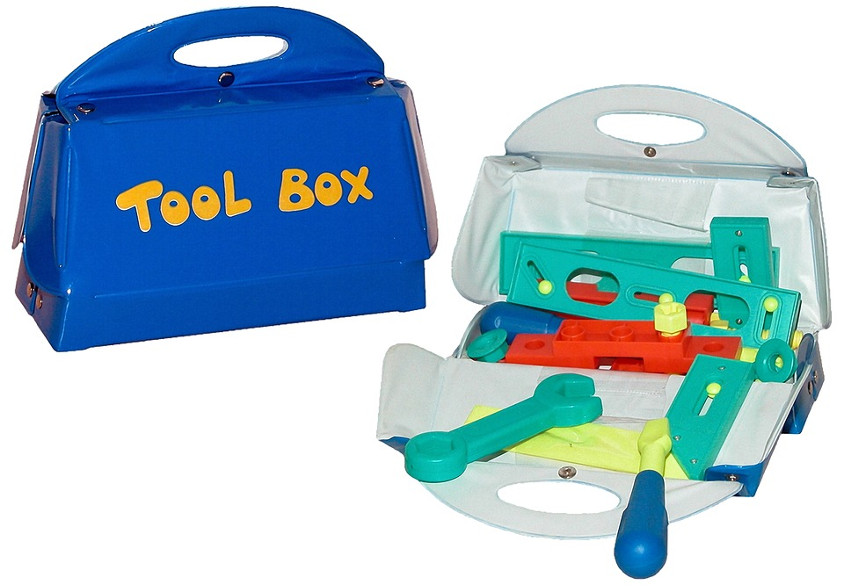
All of Us Can Do Something to Help a Suicidal Person
Everyone of us can learn how to do something to help someone who is suicidal.
You don’t need to be a health professional.
You just need a few tools or skills.
And Today you will learn some of those skills.

Slide 5
Overview of Today’s Session & What you will Learn
Reasons why we avoid the subject of suicide.
Some key risk factors for suicide & warning signs.
Learn to ask the question, “Are you having thoughts about suicide?”
What is not helpful versus what is helpful.
How to connect the suicidal person to support.
Ways that an employer, employee, organization or School campus can help.
The Importance of Self Care.
View a short role play: How to help someone who is suicidal.

Slide 6
Why Do We Avoid the Topic of Suicide?
The topic of suicide can result in many emotional reactions, including fear and shame.
You may feel very uncomfortable with the subject.
You may have lost someone to suicide.
You may have religious reasons that depict suicide as bad.
You just would rather talk about something else.
You are afraid that talking about suicide might cause harm.
Other reasons for avoiding the subject of suicide.

Slide 7
What is Important for you to know?
It is helpful for you to understand risk factors and warning signs, and how to connect a person with suicidal thoughts to support and help.

Slide 8
Key Risk Factors (as adapted from the National Suicide Prevention Lifeline, 2016)
Recent loss.
Hopelessness.
Substance misuse.
Person who is struggling with mental illness.
Person with serious other health challenges.
Lack of social support.
Previous suicide attempt.
Family member who ended their life through suicide.
Perfectionism.

Slide 9
Warning Signs (as adapted from the Canadian Association for Suicide Prevention (CASP), 2016)
Loss of interest in things a person used to enjoy.
Giving things away.
Talking about feeling hopeless or worthless.
Isolating oneself.
Decline in work or school performance.
Decline in personal hygiene.
Statements like, “What is the point of going on.”
“The World is better off without me.”
“I just can’t take the pressure any more.”
“I wish I were dead.”

Slide 10
We can all learn to feel more comfortable about talking about suicide
People who are thinking about suicide actually feel relieved if you ask them about it.
“ I was feeling really down and I knew people at work were noticing. I felt relieved when a colleague came right out and asked me if I was suicidal. It helped me not to feel ashamed for having those thoughts.”
Asking about suicidal thoughts WILL NOT make them act on them.

Slide 11
Practice asking the question, “You sound hopeless, are you having thoughts of suicide?”

Slide 12
If they admit to having Suicidal thoughts, you should be aware of WHAT IS NOT HELPFUL (as adapted from Stephany, 2007)
Do not minimize what the person is experiencing.
Avoid statements like,
“It will all be okay tomorrow.”
“We all have bad days.”
“Snap out of it.”
“You are scaring me.”
“Let’s do something fun to get your mind off of things.”
AVOID JUDGING THEM AT ALL COSTS. JUDGING CAN CAUSE THEM TO FEEL INCREASED DESPAIR

Slide 13
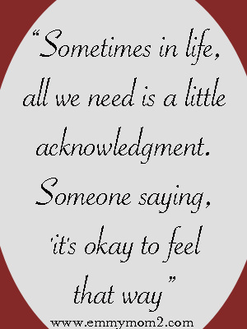
If they admit to having Suicidal thoughts, you should also be aware of WHAT IS HELPFUL (as adapted from Stephany, 2007)
Identify with what they are feeling.
Use statements like,
“You sound upset, I am here for you.”
“It must be scary to be feeling what you are feeling.”
“ I do not know how to help but I do know how to get you connected to the help that you need.”
“I do care about you and I want to connect you to support.”

Slide 14
Let them Know that They are Not Alone
Send them the Message: “I care about you.”
Bridge Story.

Slide 15
The Importance of Kindness & Care
“Too often we underestimate the power of a touch, a smile, a kind word, a listening ear, an honest compliment, or the smallest act of caring, all of which have the potential to turn a life around.”
Leo Buscaglia, Psychologist & author
CHOOSE TO BE KIND AND NOT TO BE CRUEL

Slide 16
Advice from a Patient
I asked one of my patients who had been suicidal for advice on how to be more understanding and empathetic. Here is what she said:
“Make my time with you all about me and listen to my story. Don’t judge me or try to fix anything. Be quiet and just listen to me so that I will feel that I actually matter.”

Slide 17
Listening Communicates that you care
“One of the most sincere forms of respect is actually listening to what another person has to say.” Bryant McGill, author & Human Thought Leader

Slide 18
Know what your Role is (as adapted from CASP, 2016)
It is not your role to save the other person.
But you can stay with them to ensure they are safe.
You can connect them to support through a phone number or offer to take them to see a doctor or to the ER.
Have these numbers on you, ready to share, either on a card or on your phone:
BC Suicide Helpline: 1-800-SUICIDE (1-800-794-2433)
Mental Health Support Line: 310-6789 (no area code required)

Slide 19
Ways that an Employer, Employee, Organization or School Campus Can Help (As adapted from Workplace Strategies for Mental Health, 2016)
For Employers, Employees, Organizations & School Campuses:
* Be aware of risk factors, warning signs, & ask the question, “Are you suicidal.”
* Connect the person with suicidal thoughts to support & help.
Additional Measures For Employers & Organizations to Consider:
* Consider providing access to confidential counselling services.
* For College and University campuses, Students Services usually offers free counselling.
* Create a workplace culture where people feel that it is okay to reach out for help and that they will know that they will not be penalized for doing so.
* Display posters in open areas and in bathrooms that indicate that it is okay to reach out for help and who to call.

Slide 20
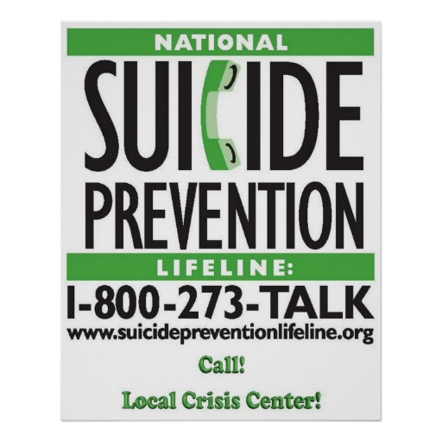
IDEAS FOR ORGANIZATIONS & POSTERS:

Slide 21
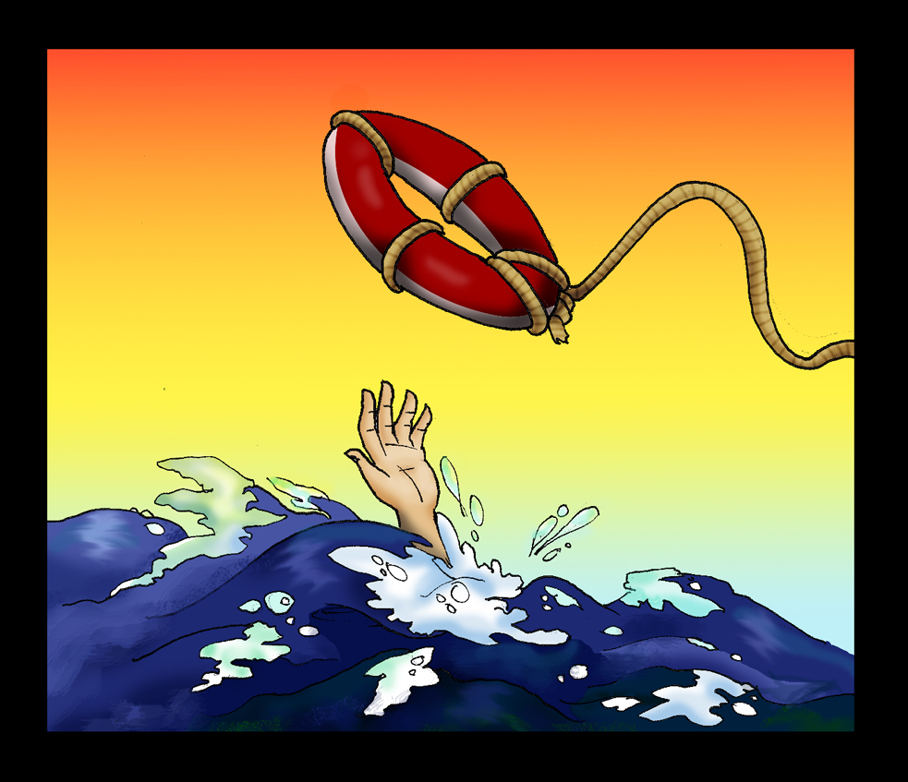
Employers, Organizations & School Campuses May want to Consider Providing Training Opportunities on How BEST to Help
Check out The Canadian Mental Health Association (CMHA) BC Division Web Site www.cmha,bc.ca
e.g., Gatekeeper Training

Slide 22
The Importance of Self-care (as adapted from Stephany, 2014)
We all need to do our very best to make self-care a priority, especially when we are confronted with other people’s suffering.
Consider doing at least one of the following:
* Connect with the goodness of life each and every day.
* Consider adopting a habit of gratitude.
* Read something positive everyday.
* Take better care of your body.
* Exercise and eat better.
* Stay connected with other people who love and support you.
* Cultivate humour.
* Reach out for help yourself.

Slide 23
How to Help Someone Who is Suicidal (brief but concise role play)
https://www.youtube.com/watch?v=CAMAnPRLMH8

Slide 24
References
Canadian Association for Suicide Prevention (CASP): Sharing Hope & Resiliency. (2016). What are the warning signs. Retrieved from: www.suicideprevention.ca/preventing/warning-signs/
National Suicide Prevention Lifeline. (2016). Suicide warning signs. Retrieved from: www.suicidepreventionlifeline.org/learn/riskfactors.aspx
Stephany, K. (2007). Suicide intervention: The importance of care as a therapeutic imperative (Doctoral Dissertation). Breyer State University, Alabama, USA.
Stephany, K. (2014). Cultivating empathy: Inspiring health professionals to communicate more effectively: United Arab Emirates: Bentham Publishing.
Workplace Strategies for Mental Health. (2016). Suicide Prevention. Retrieved from: https://www.workplacestrategiesformentalhealth.com/job-specific-strategies/suicide-prevention

Slide 26
For information please visit cmha.bc.ca

