Slide 1
Encouraging application of the Okanagan Charter in BC: Healthy Minds | Healthy Campuses
International Health Promoting Campuses Symposium
May 12, 2022
Tim Dyck & Mahboubeh Asgari
HM|HC Co-Leads

Slide 2
HM|HC in short
What?
A learning community (since 2004)
25 BC post-secondary institutions
About? promoting mental well-being and healthier
relationships with substances
equipping to navigate and thrive together
enhancing campus environments and members’ resilience
maximizing benefits and minimizing harms from use of drugs
E-newsletter
Website
Talks, Info Sessions
Summits, Regional Forums
Joint Projects
Means?

Slide 3
HM|HC on generating and exchanging knowledge
Health knowledge (literacy) is:
It’s aptly applied in joint endeavour:
embracing diversity, ensuring inclusion, seeking equity
valuing community, sharing power, committing to collaboration
upholding personal agency and social responsibility
eroding stigma by recognizing “all of us” rather than “we and them”
far more than awareness of content, including formal research findings
about acquiring competencies through experiential learning, active inquiry, development of moral reasoning
developed through multi-directional interchange, reciprocal investigation

Slide 4
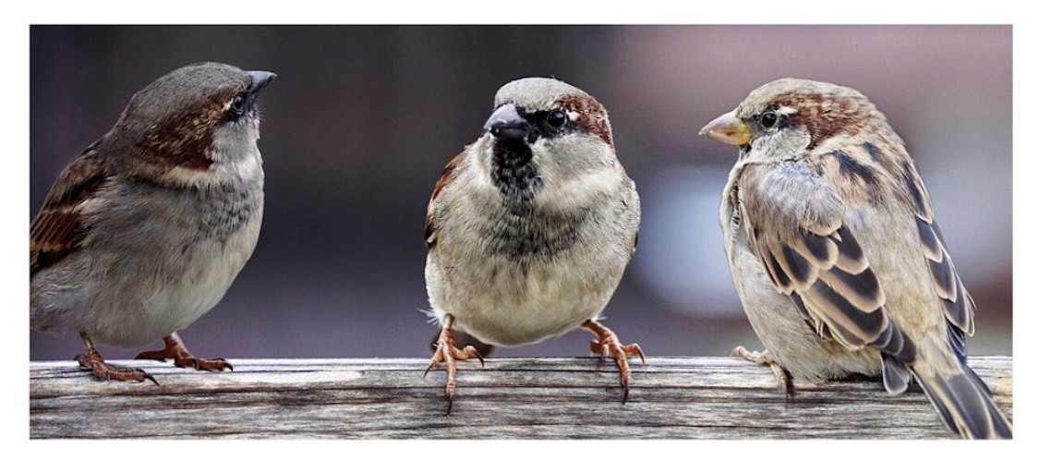
HM|HC on practicing dialogue
What’s dialogue?
A way of being in the world
A unique form of conversation
Creating the ‘container’
Practicing dialogue
Listening
Openness
Empathy
Asking questions

Slide 5
HM|HC on practicing dialogue
Why dialogue?
Increase respect and appreciation
Act together
Increase understanding
Build connectedness

Slide 6
HM|HC on assessing impact
Responding to people (versus following a formula):
Considerations:
How to do justice to interplay of influences, agents’ assumptions, values, beliefs, motives …?
Do metrics & method capture ends first confirmed and then attested by the subjects themselves?
Don’t we really need continued conversation on progress on and potential for desired capacity?
Reasons rather than causes
Participant value instead of external objective
Ongoing possibilities in contrast to settled results

Slide 7
Some HM|HC questions for reflection
How might health promotion principles as cited in the Okanagan Charter be more consistently applied in our knowledge generation and exchange efforts in post-secondary settings?
2. How might we better promote and practice dialogue as a crucial component in meaningful, healthy
culture change in our campus contexts?
3. What are our biggest challenges and the most promising ways forward in applying a responsive
approach to evaluation of our efforts to build capacity?

Slide 8
Contact
tdyck@uvic.ca
mahboubeh.asgari@cmha.bc.ca
www.healthycampuses.ca

